Slide 1

AI with Business Functions
This presentation explores the transformative power of artificial intelligence (AI) in revolutionizing key business functions, unlocking new levels of efficiency, and driving sustainable growth.
am
by akshaya manoj

Slide 2
Introduction to AI and its Impact on Business
Defining AI
Business Impact
AI refers to computer systems that mimic human intelligence. These systems learn from data, adapt to new situations, and perform tasks that traditionally required human intervention.
AI's impact on businesses is profound, ranging from automated tasks to personalized experiences, predictive analytics, and decision-making support.

Slide 3
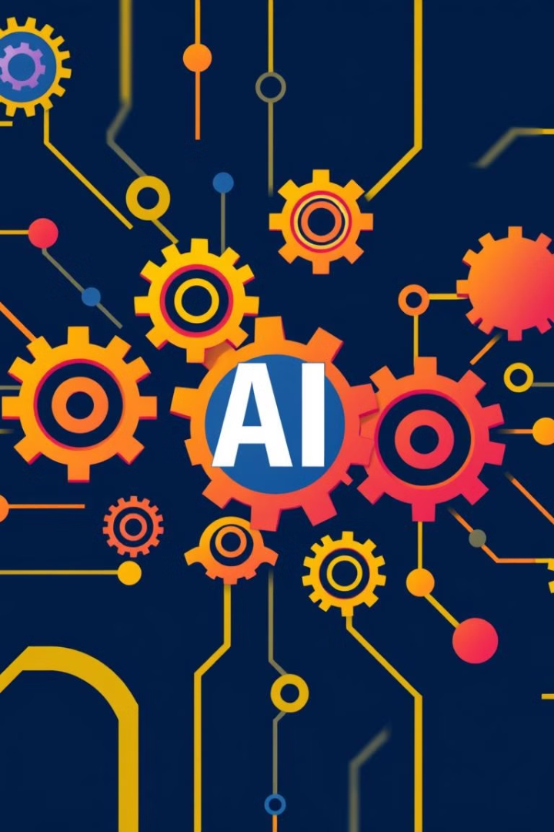
Key Business Functions Benefiting from AI
Marketing
Sales
AI helps target customers with personalized content, automate marketing campaigns, analyze campaign performance, and predict customer behavior.
AI provides insights to identify leads, predict sales, optimize pricing strategies, and automate customer interactions.
Operations
Customer Service
AI enables automation of repetitive tasks, improves supply chain optimization, streamlines logistics, and enhances resource management.
AI powers chatbots for automated customer support, analyzes customer feedback for sentiment analysis, and personalizes customer interactions.

Slide 4





Generative AI: The Next Frontier in Productivity
Content Creation
Code Generation
Generative AI can produce high-quality text, images, audio, and video content, boosting content creation efficiency and creativity.
AI assists developers in generating code, reducing development time, and improving software quality.
Data Analysis
Personalized Experiences
Generative AI can analyze vast amounts of data, identifying patterns, generating insights, and creating visualizations.
Generative AI personalizes customer interactions, tailoring products and services to individual needs and preferences.

Slide 5
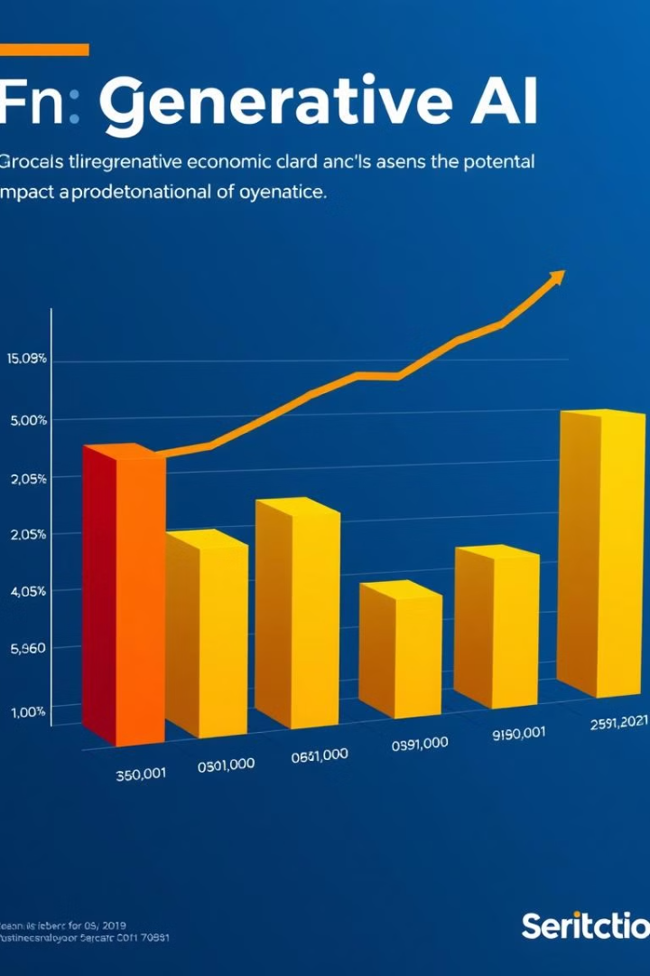
Estimating the Economic Potential of Generative AI
10T
13%
Trillion
Increased Efficiency
Generative AI is projected to contribute trillions of dollars to the global economy by 2030, accelerating innovation and productivity.
Generative AI can boost efficiency across business functions by up to 13%, creating significant cost savings and driving profitability.

Slide 6
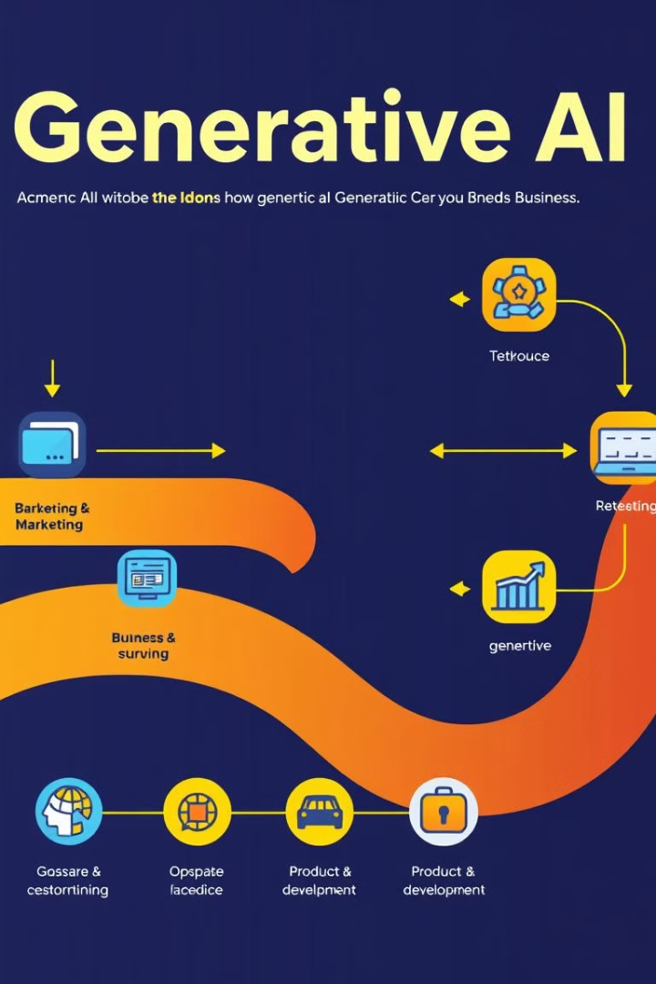
Generative AI's Impact Across Business Functions
1
Marketing
Generative AI personalizes content, automates creative tasks, and predicts customer behavior, enhancing marketing campaign effectiveness.
2
Sales
Generative AI provides insights to identify leads, generate personalized sales pitches, and automate follow-up interactions, increasing sales conversion rates.
3
Operations
Generative AI optimizes supply chains, automates production processes, and improves resource allocation, enhancing operational efficiency and reducing costs.
4
Customer Service
Generative AI powers chatbots for personalized customer support, analyzes feedback for sentiment analysis, and provides insights to improve customer experience.

Slide 7
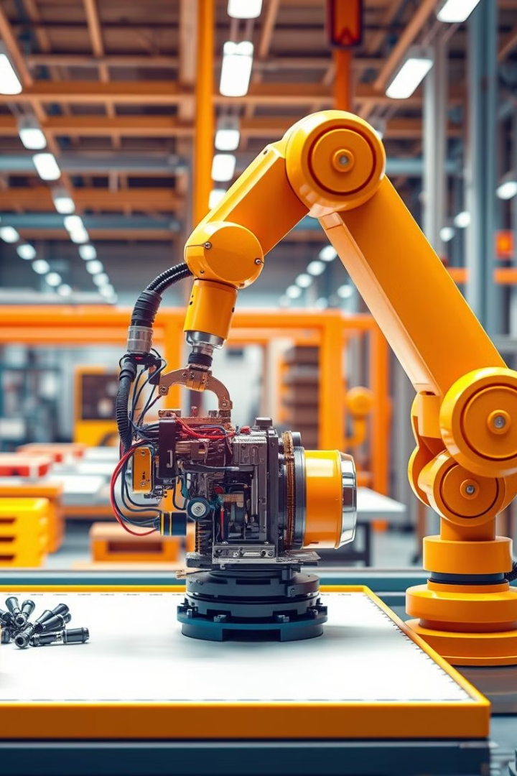



Boosting Productivity Through AI-Enabled Automation
Task Automation
AI automates repetitive tasks, freeing up human workers to focus on higher-value activities, improving efficiency and productivity.
Process Optimization
AI analyzes data to identify inefficiencies and suggests process improvements, streamlining workflows and reducing bottlenecks.
Decision Support
AI provides insights and recommendations to support informed decision-making, reducing human error and improving outcomes.

Slide 8
Accelerating the Transformation of Knowledge Work
Enhanced Creativity
1
Generative AI assists knowledge workers in generating new ideas, brainstorming solutions, and creating innovative outputs.
Improved Collaboration
2
AI facilitates collaboration by connecting knowledge workers across teams, sharing insights, and providing access to relevant information.
Faster Learning
3
AI provides personalized learning experiences, tailoring educational content to individual needs and accelerating knowledge acquisition.

Slide 9



Unlocking Economic Growth Through AI Adoption
Increased Productivity
1
AI drives productivity gains, leading to increased output and economic growth.
Job Creation
2
AI creates new jobs in fields related to AI development, implementation, and maintenance.
Innovation
3
AI fuels innovation, leading to new products, services, and industries, driving economic growth and societal progress.

Slide 10



Preparing for the Challenges and Opportunities of Generative AI

